Slide 1

Python for
Data Science
April 17, 2018
https://bit.ly/2ESypJB

Slide 2


https://bit.ly/2ESypJB
Instructors
Heather Chen
Senior
Applied Math + City Planning
Jun Seo Park
Junior
Statistics + Data Science

Slide 3
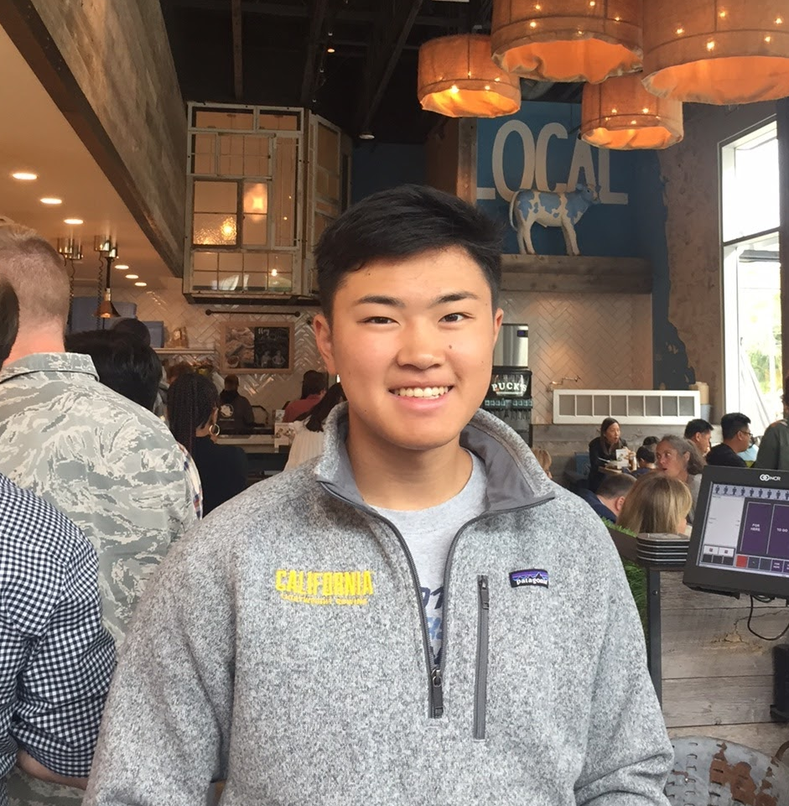

https://bit.ly/2ESypJB
Teaching Assistants
Alex Nakagawa
Sophomore
Cognitive Science
Kat Chua
Sophomore
Political Economy

Slide 4
https://bit.ly/2ESypJB
Agenda
6:10pm: Introductions / Setup
6:20pm: Defining variables, variable types, operations
6:40pm: Lists and loops
6:55pm: Open Q+A on everything covered so far!
7:00pm: Begin data science! Loading data, EDA, and aggregates
7:30pm: Graphing with Matplotlib
7:50pm: Joins
7:55pm: Q+A

Slide 5
Setting up Anaconda
https://bit.ly/2ESypJB
Mac: Python 3.6
https://www.anaconda.com/download/#macos
Windows: https://medium.com/@GalarnykMichael/install- python-on-windows-anaconda-c63c7c3d1444

Slide 6

What is Python?
Easy to use
Many libraries
Easy to read
Popular for data science

Slide 7
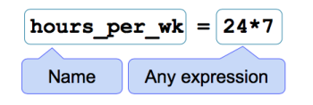
Defining Variables
Examples:
num_oranges = 10
num_apples = 5
my_name = “Heather”
student = True
student_ages = [20, 21, 24, 19]
Notes:
things to point out: can assign variables to anything!

Slide 8
Types
Numbers
1, 9, 5, etc
Booleans
True, False
Strings
“name”, “apple”, “67”
and many more!
Notes:
saw different types in the previous slide, which types were those?

Slide 9
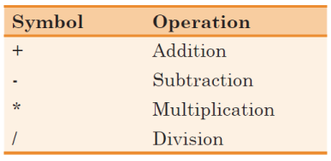
Operations in Python
Examples:
totalFruit = 10+5
salesPerMonth = 4000/12
allfruit = num_oranges + num_apples

Slide 10
Operations in Python
Operations only work on objects of the same TYPE.
python >> 5 + 5
python >> 5 + ‘5’
python >> “Store” + “Name”

Slide 11
Operations in Python
Python can only add objects of the same TYPE.
python >> 5 + 5
10
python >> 5 + ‘5’
TypeError: unsupported operand type(s) for +: 'int' and 'str'
python >> “Store” + “Name”
“StoreName”
Notes:
debugging is important as an independent programmer

Slide 12
Booleans (T/F)
python >> 5 == 6
False
python >> 5 == 5
True
python >> 10 != 5
True
python >> (10+8) > 20
False
Notes:
Booleans: we use notation == and !=, and > < just like in regular math

Slide 13
Booleans (T/F)
python >> num_students = 20
python >> num_teachers = 2
python >> num_students < num_teachers
?

Slide 14
Booleans (T/F)
python >> num_students = 20
python >> num_teachers = 2
python >> num_students < num_teachers
False

Slide 15
EXERCISE

Slide 16
Lists
Why? Storing similar information in one place.
Data found in CSV’s and tables are stored as lists.
Examples:
student_ages = [20, 21, 24, 19]
fruits_sold = [‘pear’, ‘apple’, ‘mango’, ‘kiwi’]

Slide 17
Indexing (Lists)
Accessing data in lists
student_ages = [20, 21, 24, 19]
python >> student_ages[0]
20
python >> student_ages[2]
24
Notes:
point out that it starts at 0

Slide 18
Indexing (Lists)
Accessing data in lists
student_ages = [20, 21, 24, 19]
python >> student_ages[0:3]
[20, 21, 24] - exclusive (not including index 3)
python >> student_ages[4]
ERROR

Slide 19
Aggregating (Lists)
student_ages = [20, 21, 24, 19]
python >> sum(student_ages)
84
python >> len(student_ages)
4

Slide 20
Aggregating (Lists)
student_ages = [20, 21, 24, 19]
Calculating the mean:
sum(student_ages)/len(student_ages)
This is tedious - instead, use library called numpy:
python >> import numpy as np
python >> np.mean(student_ages)
21

Slide 21
For Loops
python >> ages_of_cats = [2, 4, 6, 1, 3, 5]
python >> for age in ages_of_cats:
print(age+1)

Slide 22
For Loops
challenge:
python >> ages_of_cats = [2, 4, 6, 1, 3, 5]
python >> for i in np.arange(len(ages_of_cats)):
ages_of_cats[i] = ages_of_cats[i] + 1
np.arange(len(ages_of_cats)) = [0,1,2,3,4,5]
python >> ages_of_cats
[3, 5, 7, 2, 4, 6]

Slide 23
EXERCISE

Slide 24
Q+A

Slide 25

Pandas
Pandas is a library, just like numpy
Use pandas for accessing, manipulating, creating, and analyzing tables of data

Slide 26
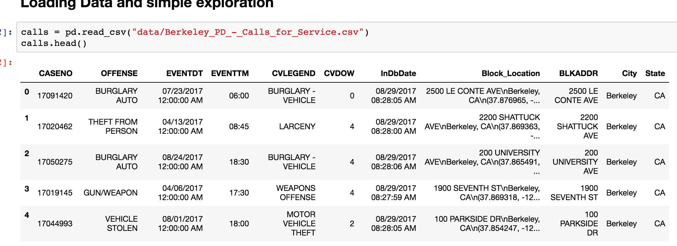
Pandas DataFrame (table)
calls is the name of our dataframe

Slide 27
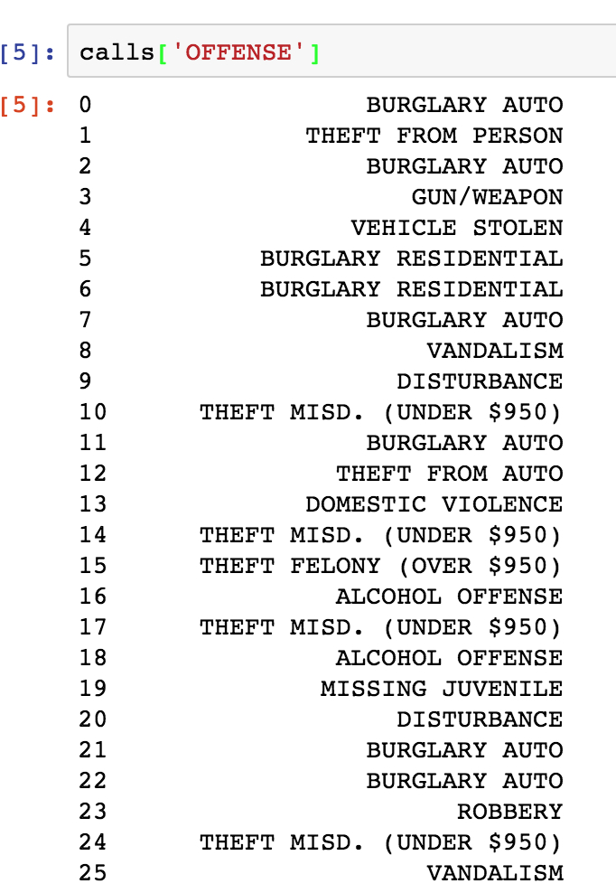
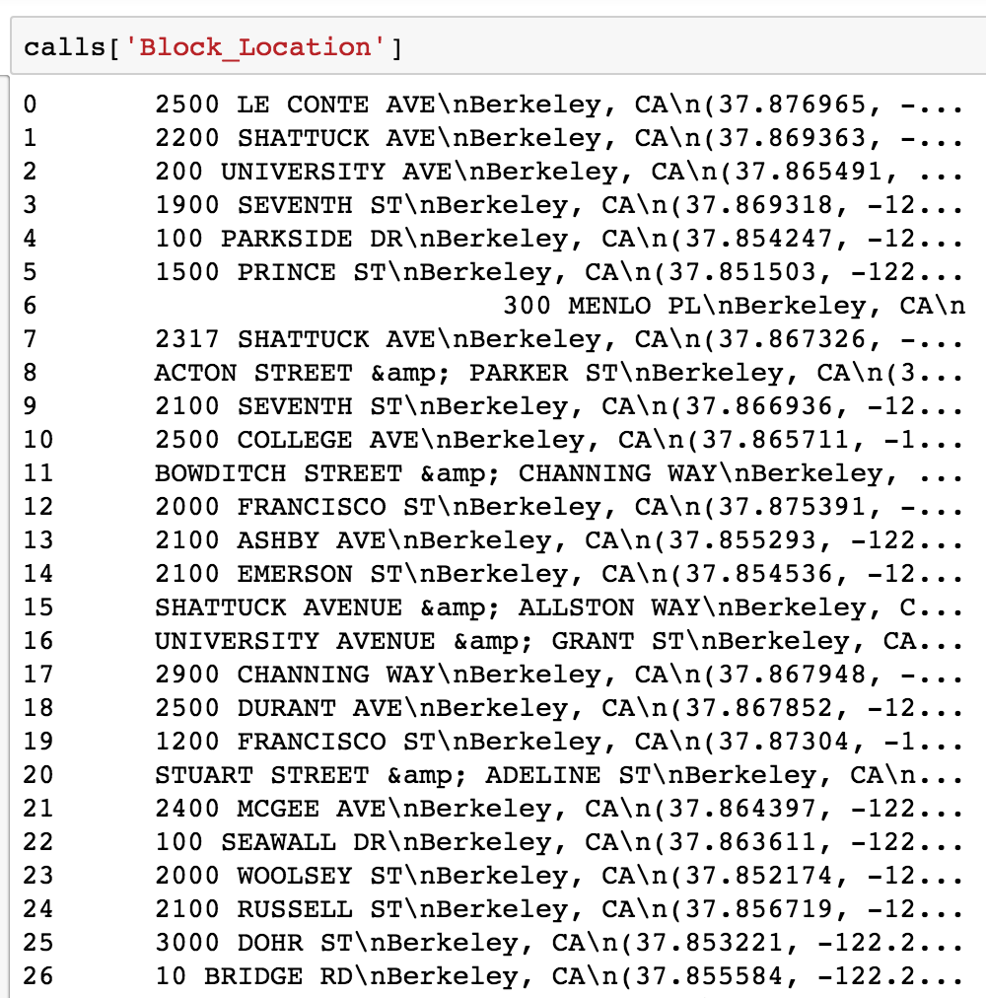
Pandas Series (column)
Access using this format:
dataframename[columnname]
>> calls[‘OFFENSE’]
>> calls[‘Block_Location’]
Notes:
loc, iloc

Slide 28
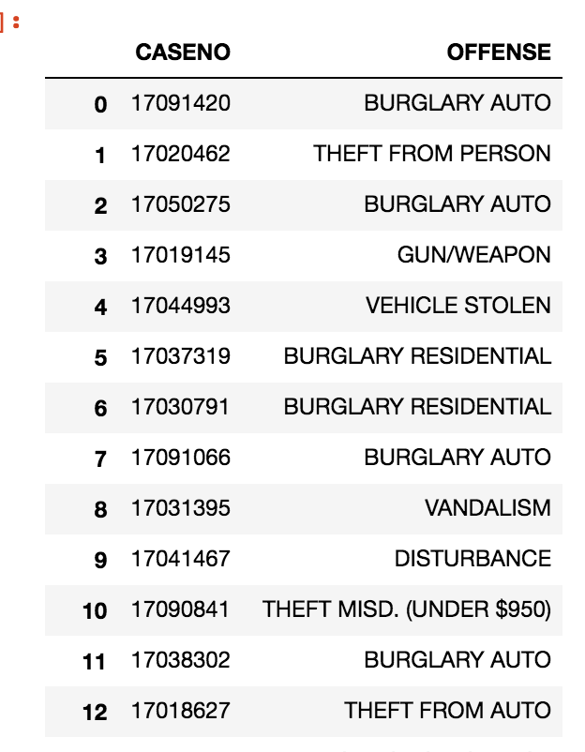
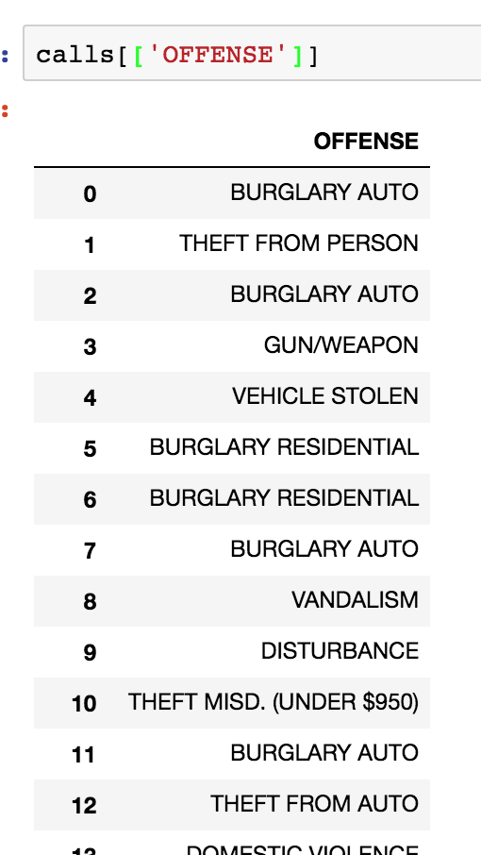
Accessing data: Using Double Brackets
>> calls[[‘OFFENSE’]]
>> calls[[‘CASENO’, ‘OFFENSE’]]
Notes:
loc, iloc

Slide 29
Accessing data: df.loc[ ] and df.iloc[ ]
- df.loc[ ] is used with column names
Example:
>> calls.loc[:, [‘OFFENSE’]]
will give you all rows of the column ‘OFFENSE’
- df.iloc[ ] is used with column indices
Example:
>> calls.iloc[:, [0, 1, 2]]
will give you all rows of the 0th, 1st, and 2nd columns
Notes:
loc, iloc

Slide 30
Filtering our data
I want only police calls where ‘OFFENSE’ is ‘BURGLARY AUTO’
Using brackets:
>> calls[calls['OFFENSE'] == 'BURGLARY AUTO']
Using .loc:
>> calls.loc[calls['OFFENSE']=='BURGLARY AUTO']
Notes:
loc, iloc

Slide 31
EXERCISE

Slide 32
Grouping data
dataframe.groupby(columnname).aggregatefunction()
Want to find number of police calls for each type of offense
>> calls.groupby(‘OFFENSE’).count()
Other types of aggregation:
mean, standard deviation, sum, and more!
Notes:
loc, iloc

Slide 33
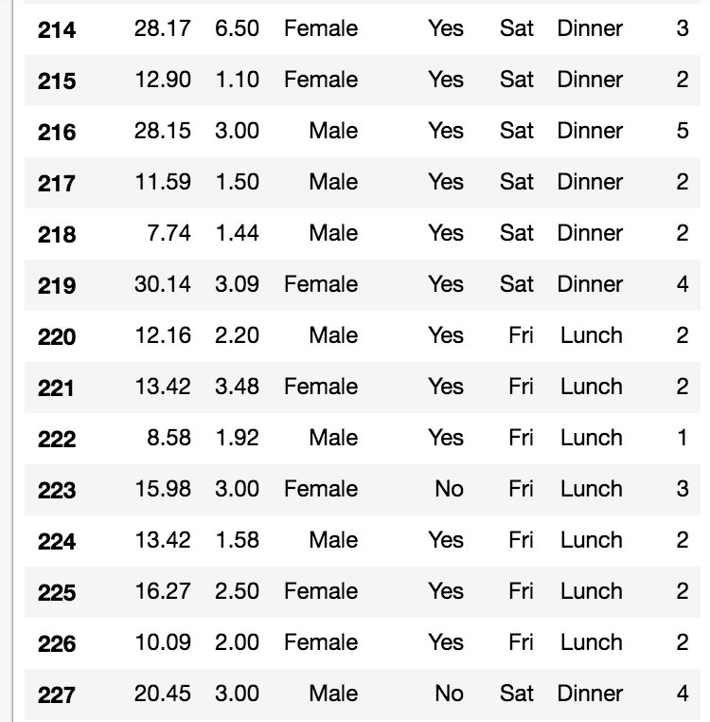
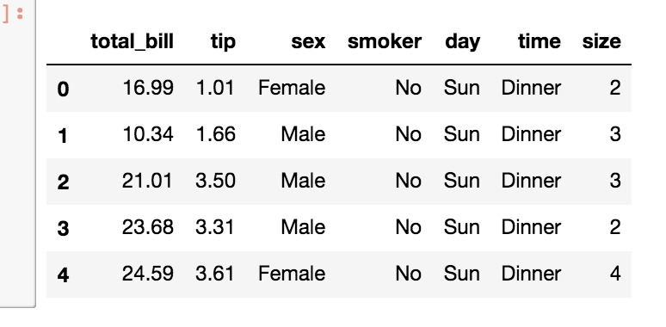
Grouping data
dataframe.groupby(columnname).aggregatefunction()
What are some questions we can answer
with groupby?
Notes:
loc, iloc

Slide 34
EXERCISE

Slide 35
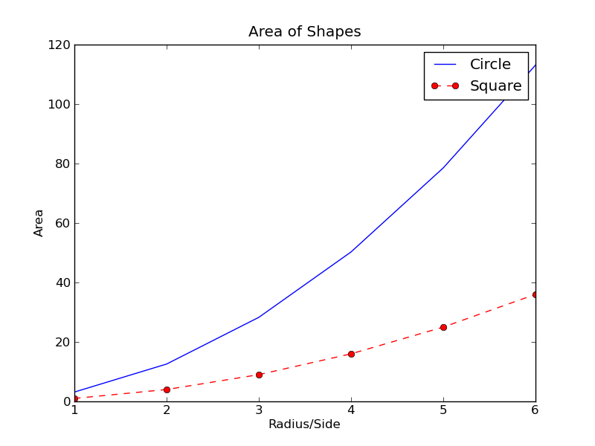
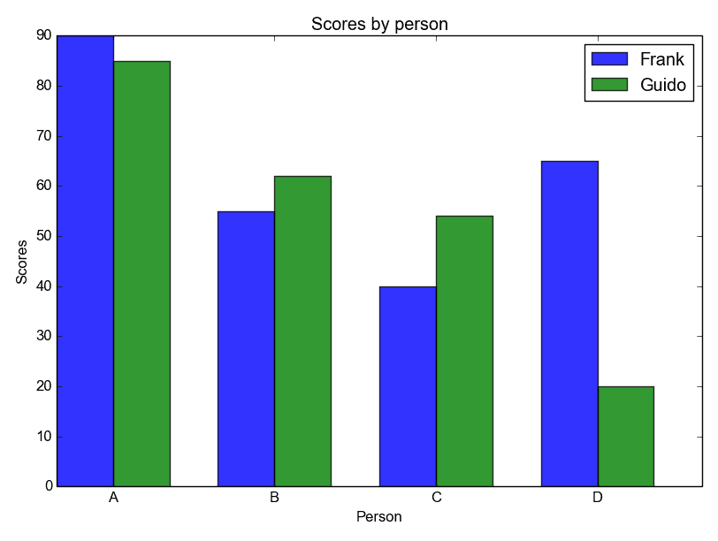
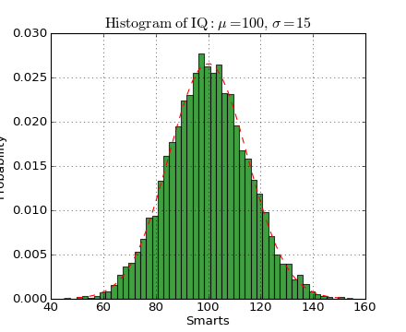
Graphing!
Use a library called matplotlib
>> import matplotlib.pyplot as plt
Notes:
loc, iloc

Slide 36
Graphing!
How to create graphs using code:
>> import matplotlib.pyplot as plt
plt.scatter(x_values_as_an_array, y_values_as_an_array)
Example:
>> plt.scatter(tips[‘total_bill’], tips[‘tip’])
Other types of plots:
plt.bar( ), plt.hist( )
Notes:
loc, iloc

Slide 37
EXERCISE

Slide 38
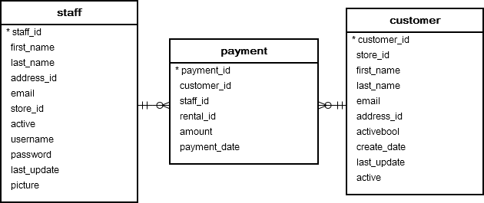
Joins:
putting multiple tables together

Slide 39
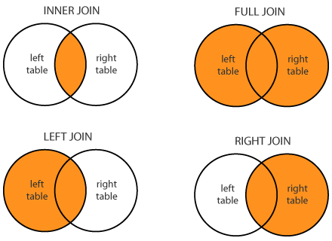

Slide 40
Additional Resources
Pandas documentation: https://pandas.pydata.org/pandas-docs/stable/
https://www.datacamp.com/
https://www.youtube.com/user/thenewboston/videos
https://chrisalbon.com/
http://data8.org/sp18/ (Berkeley intro data science course)
Google!

Slide 41
Thank you!

